Slide 2
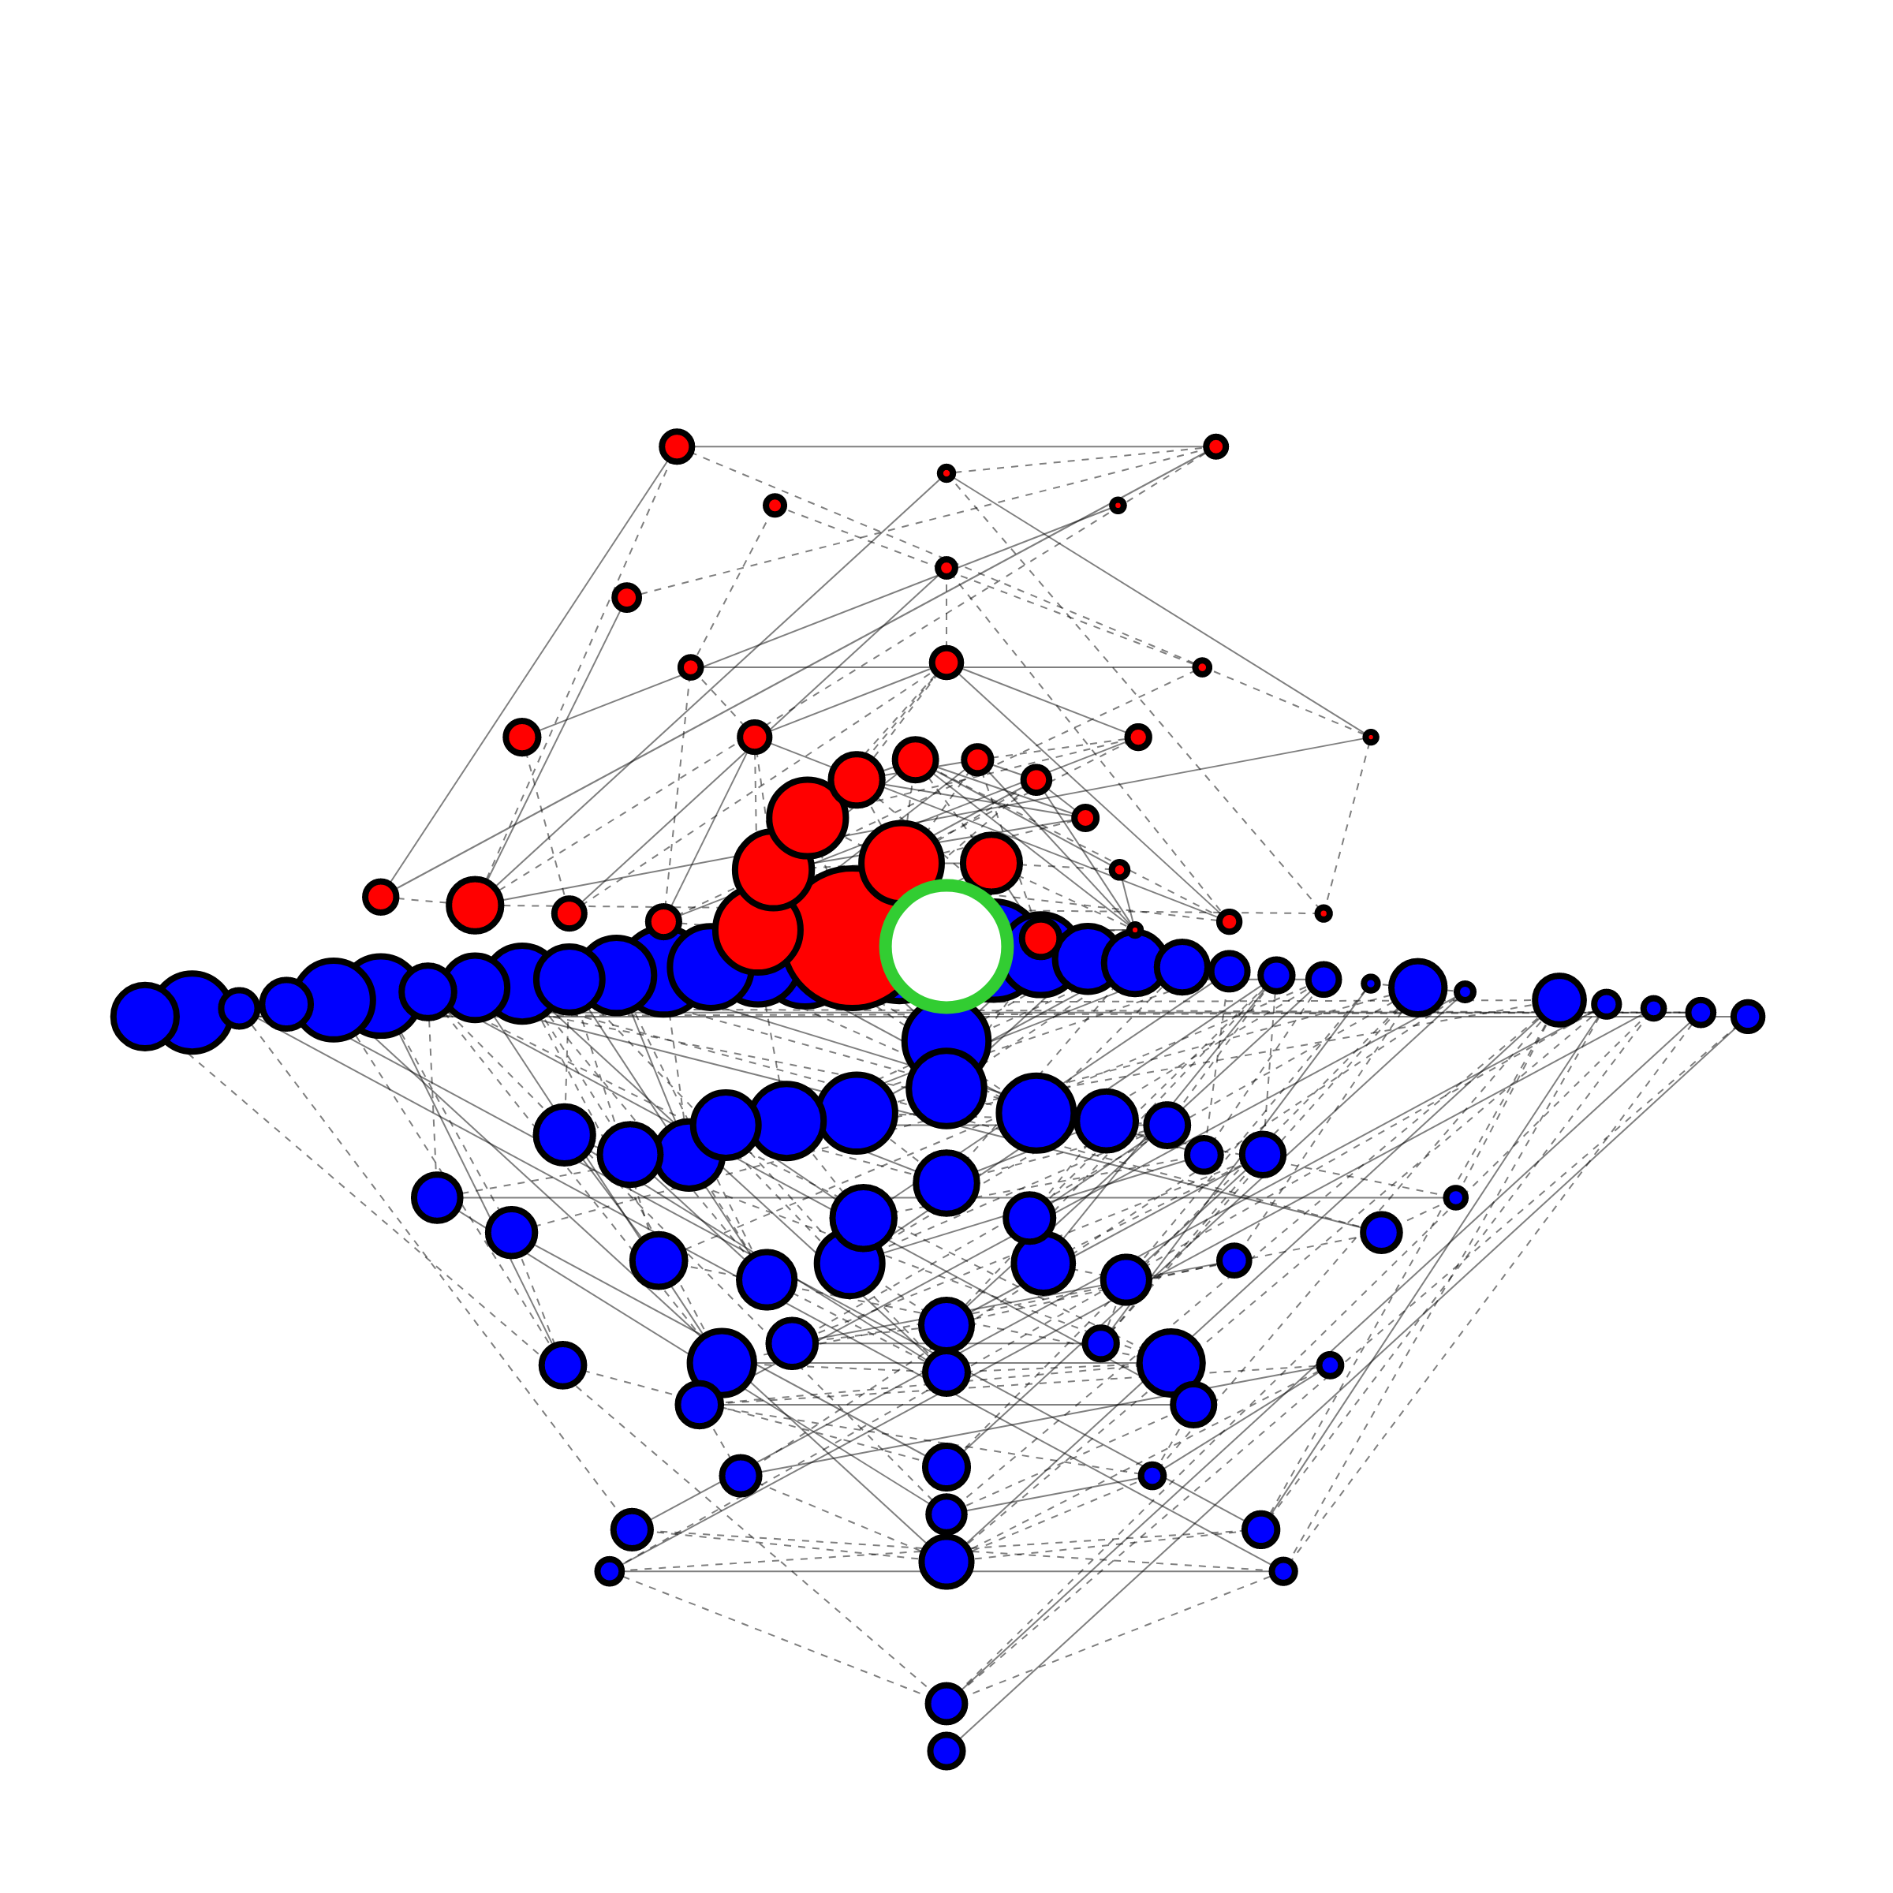
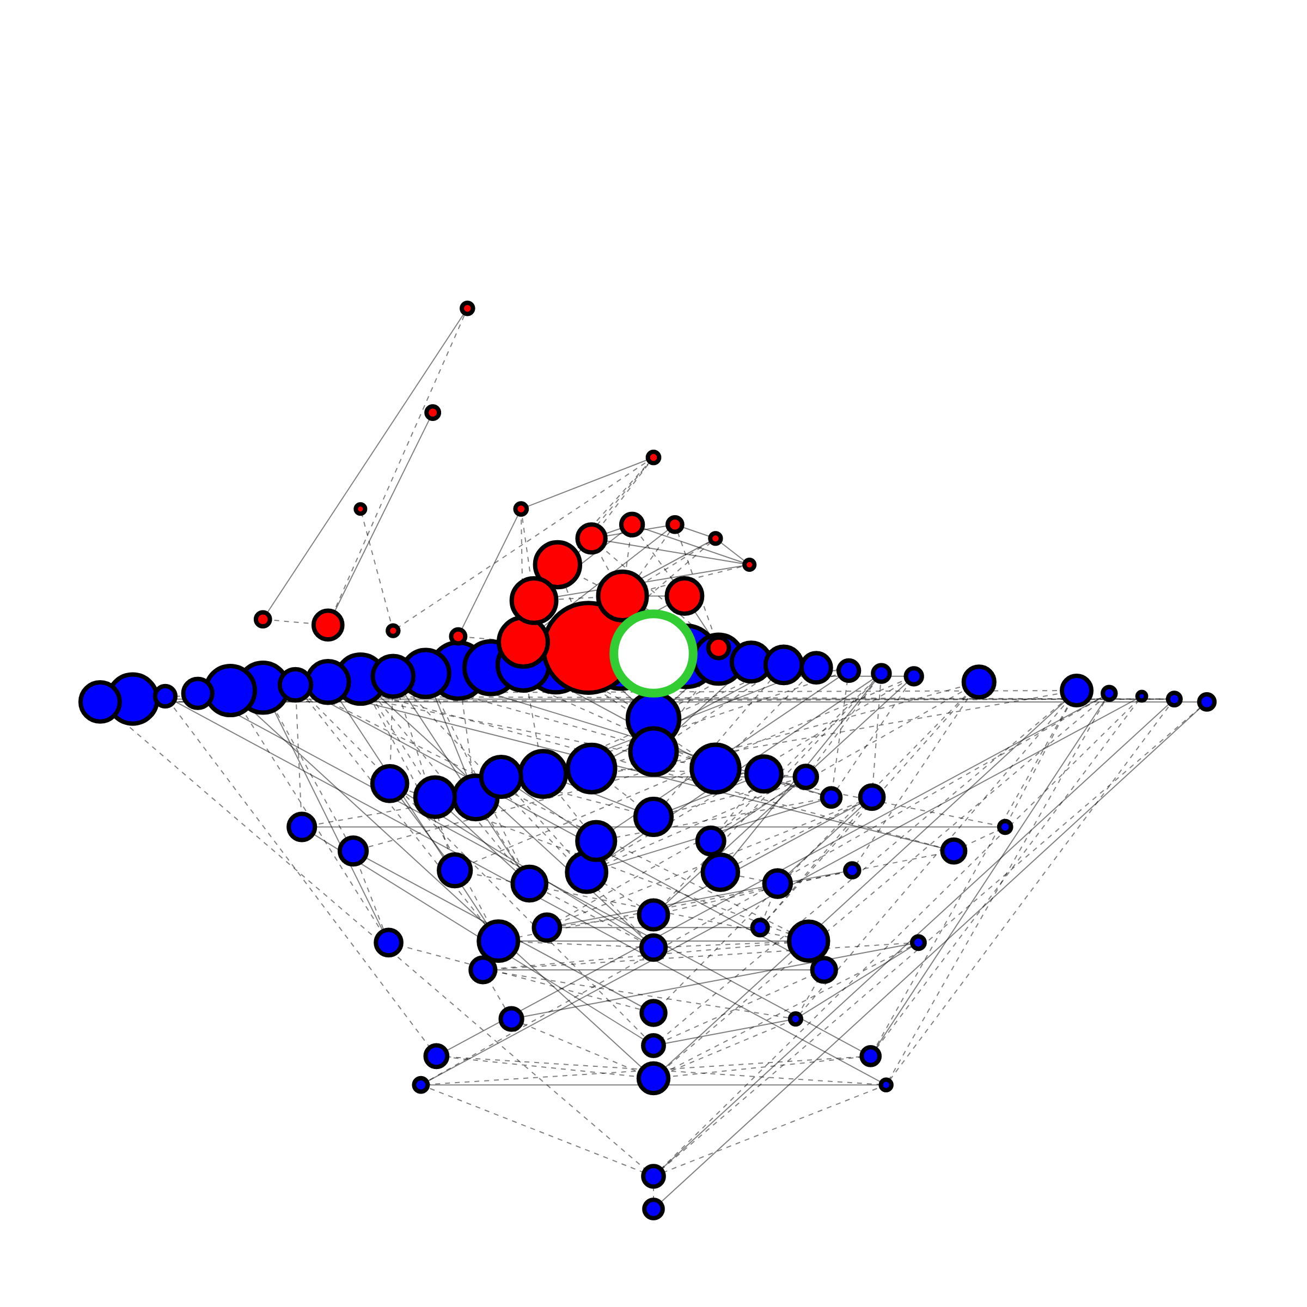
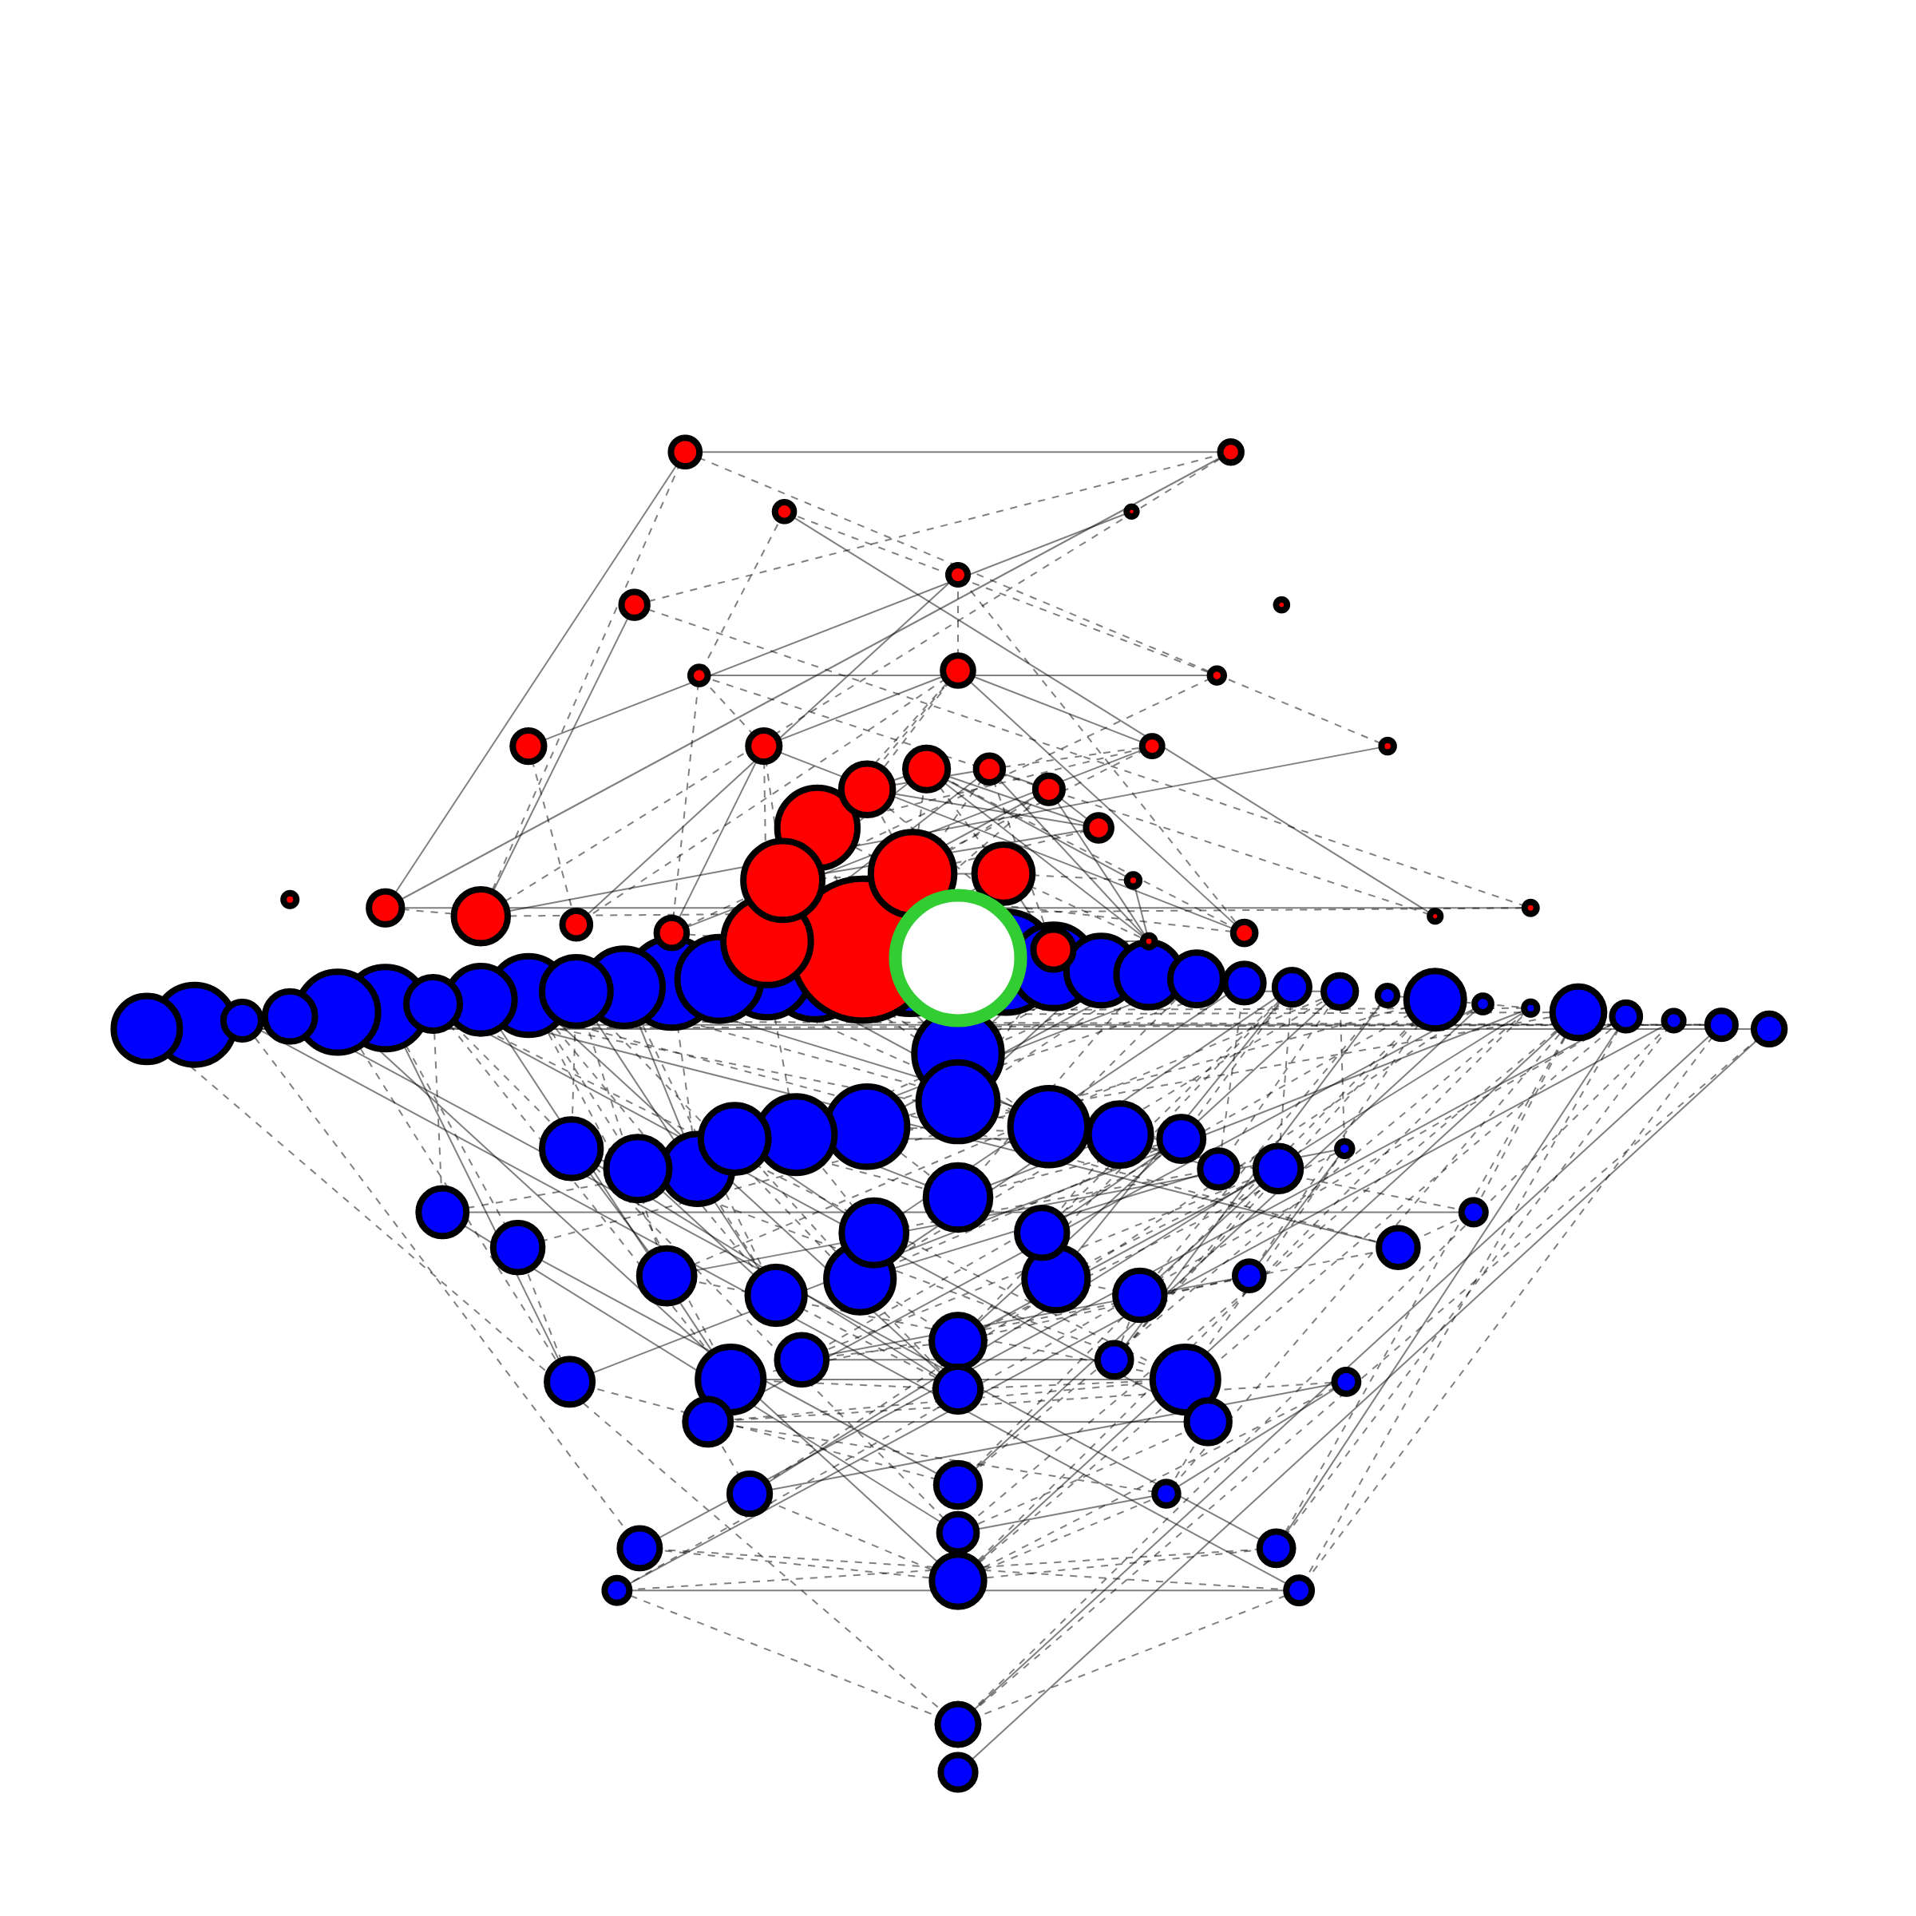

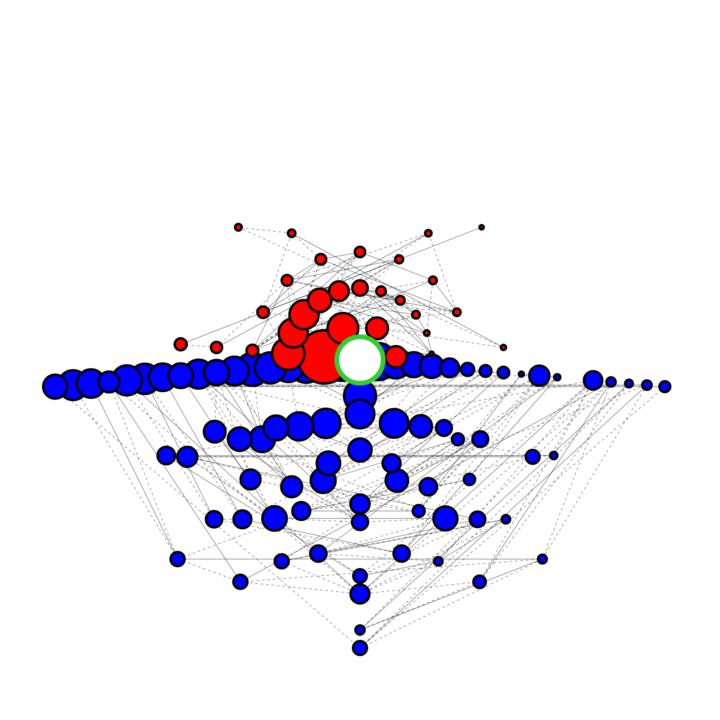
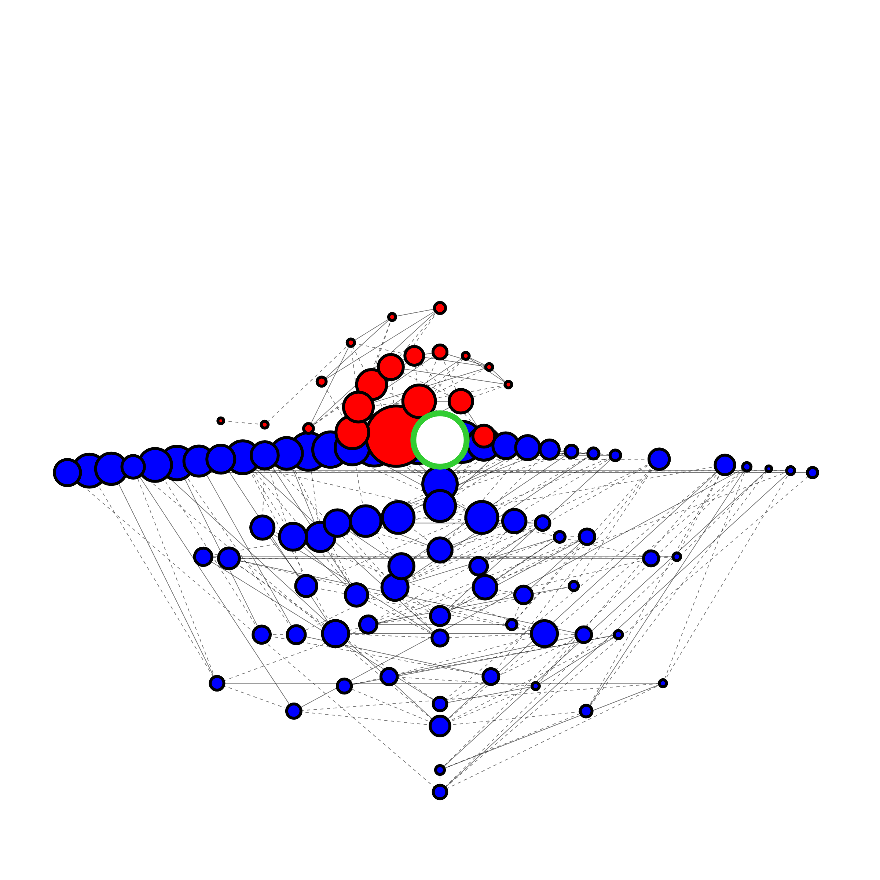

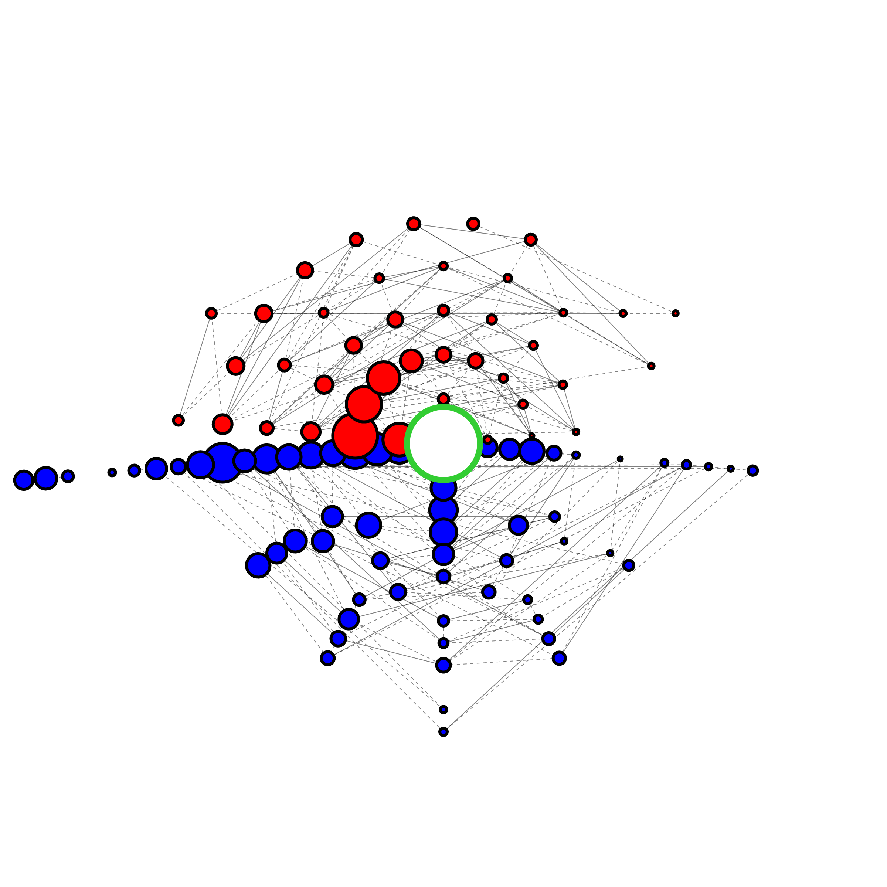
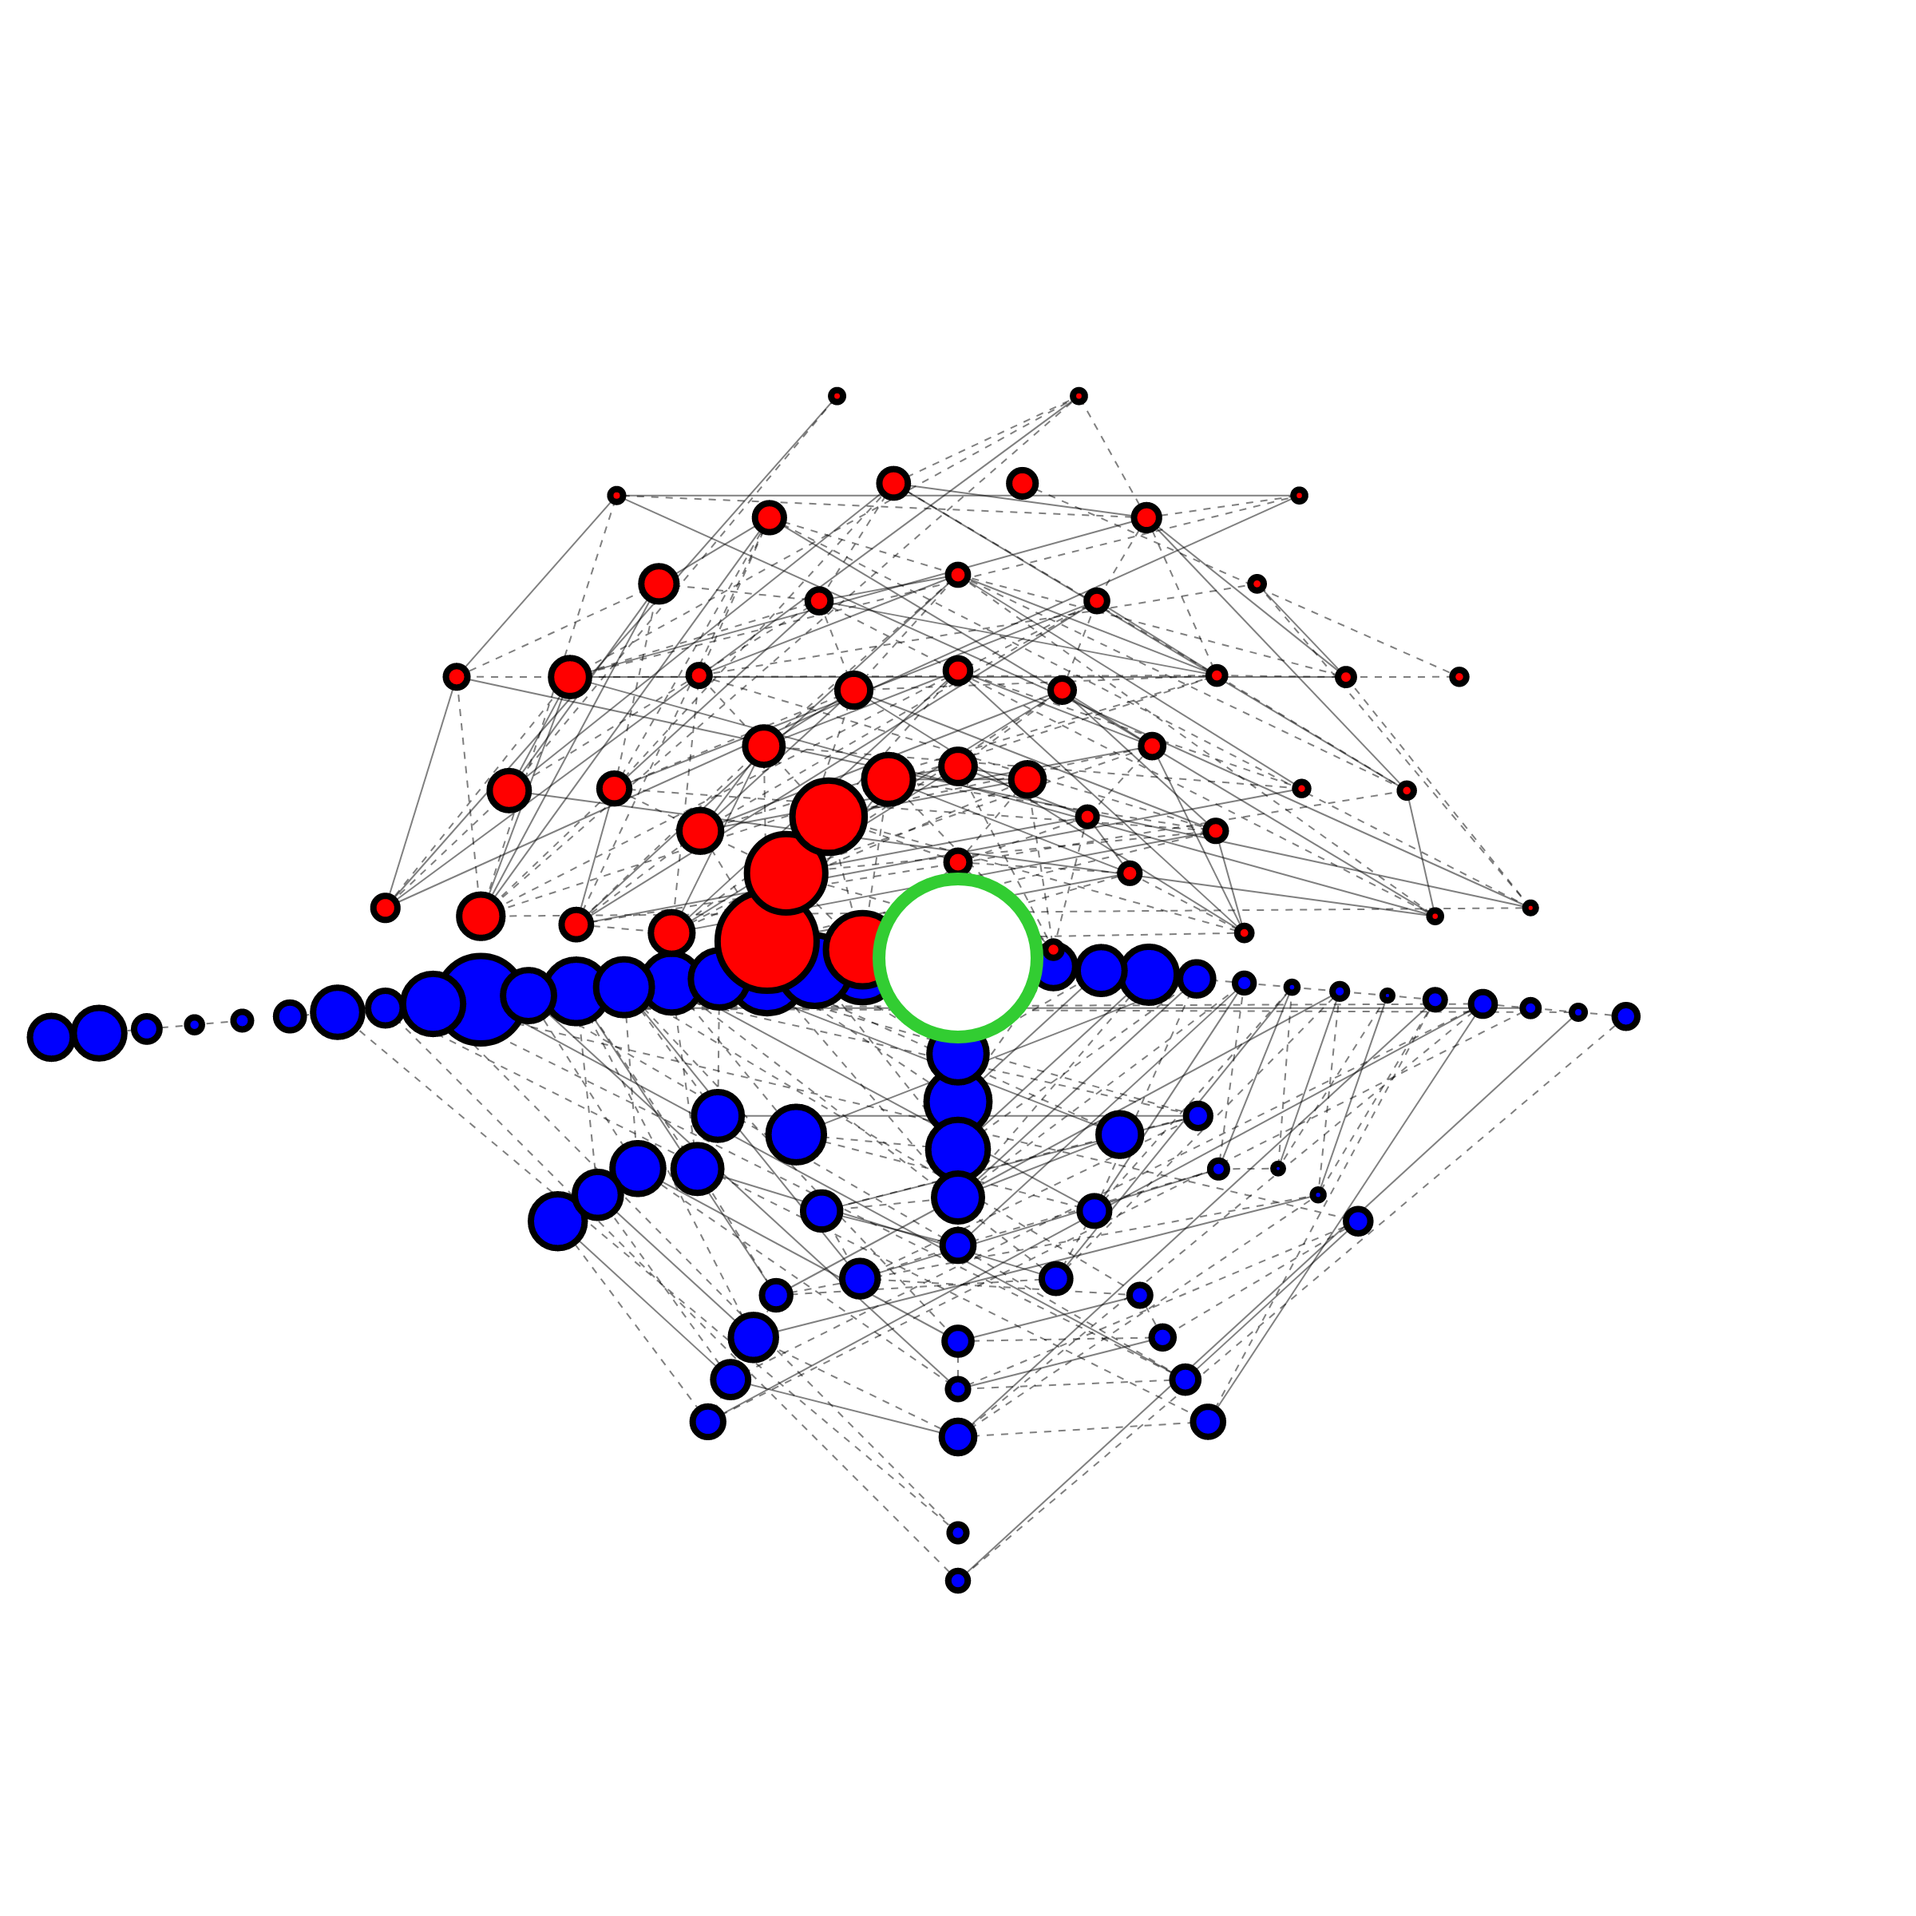
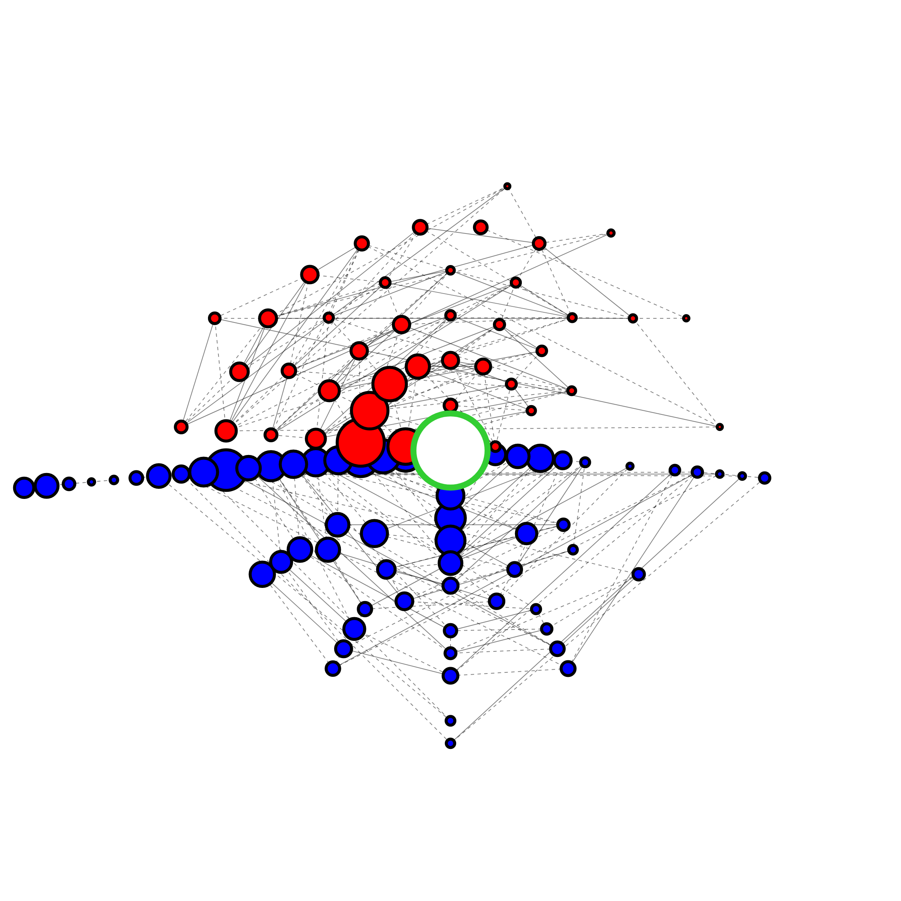
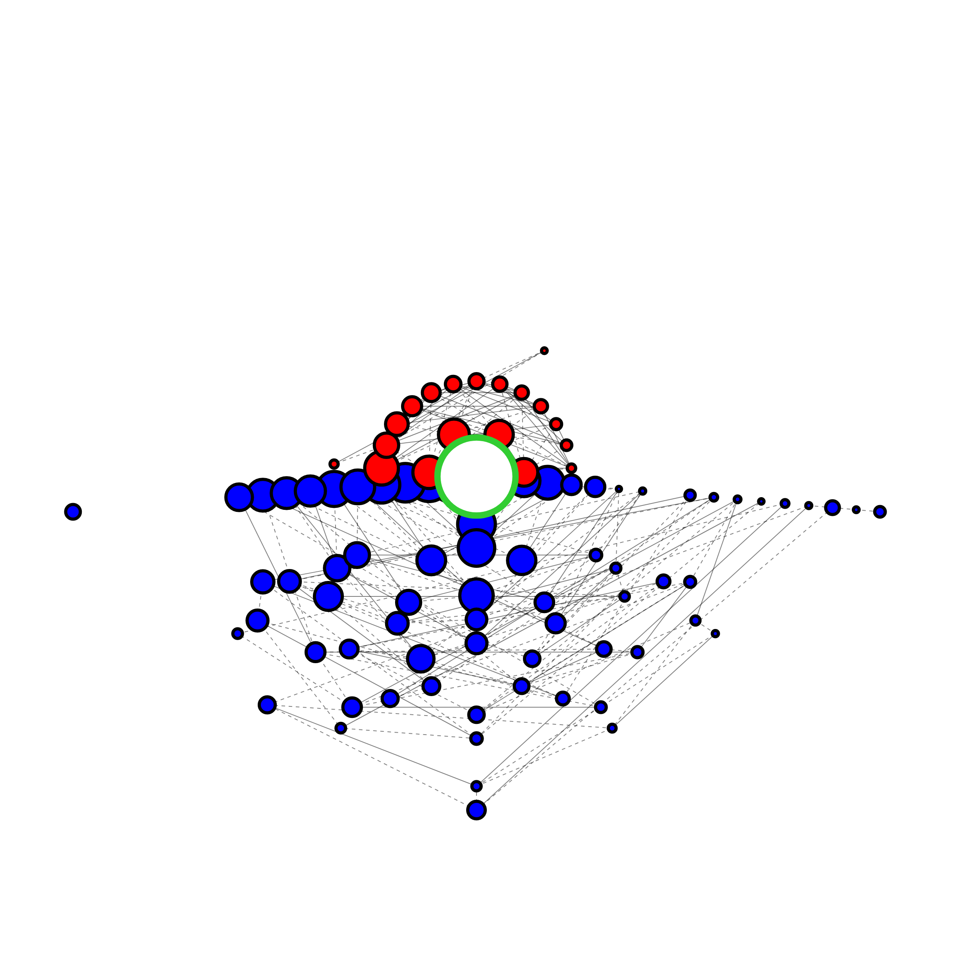
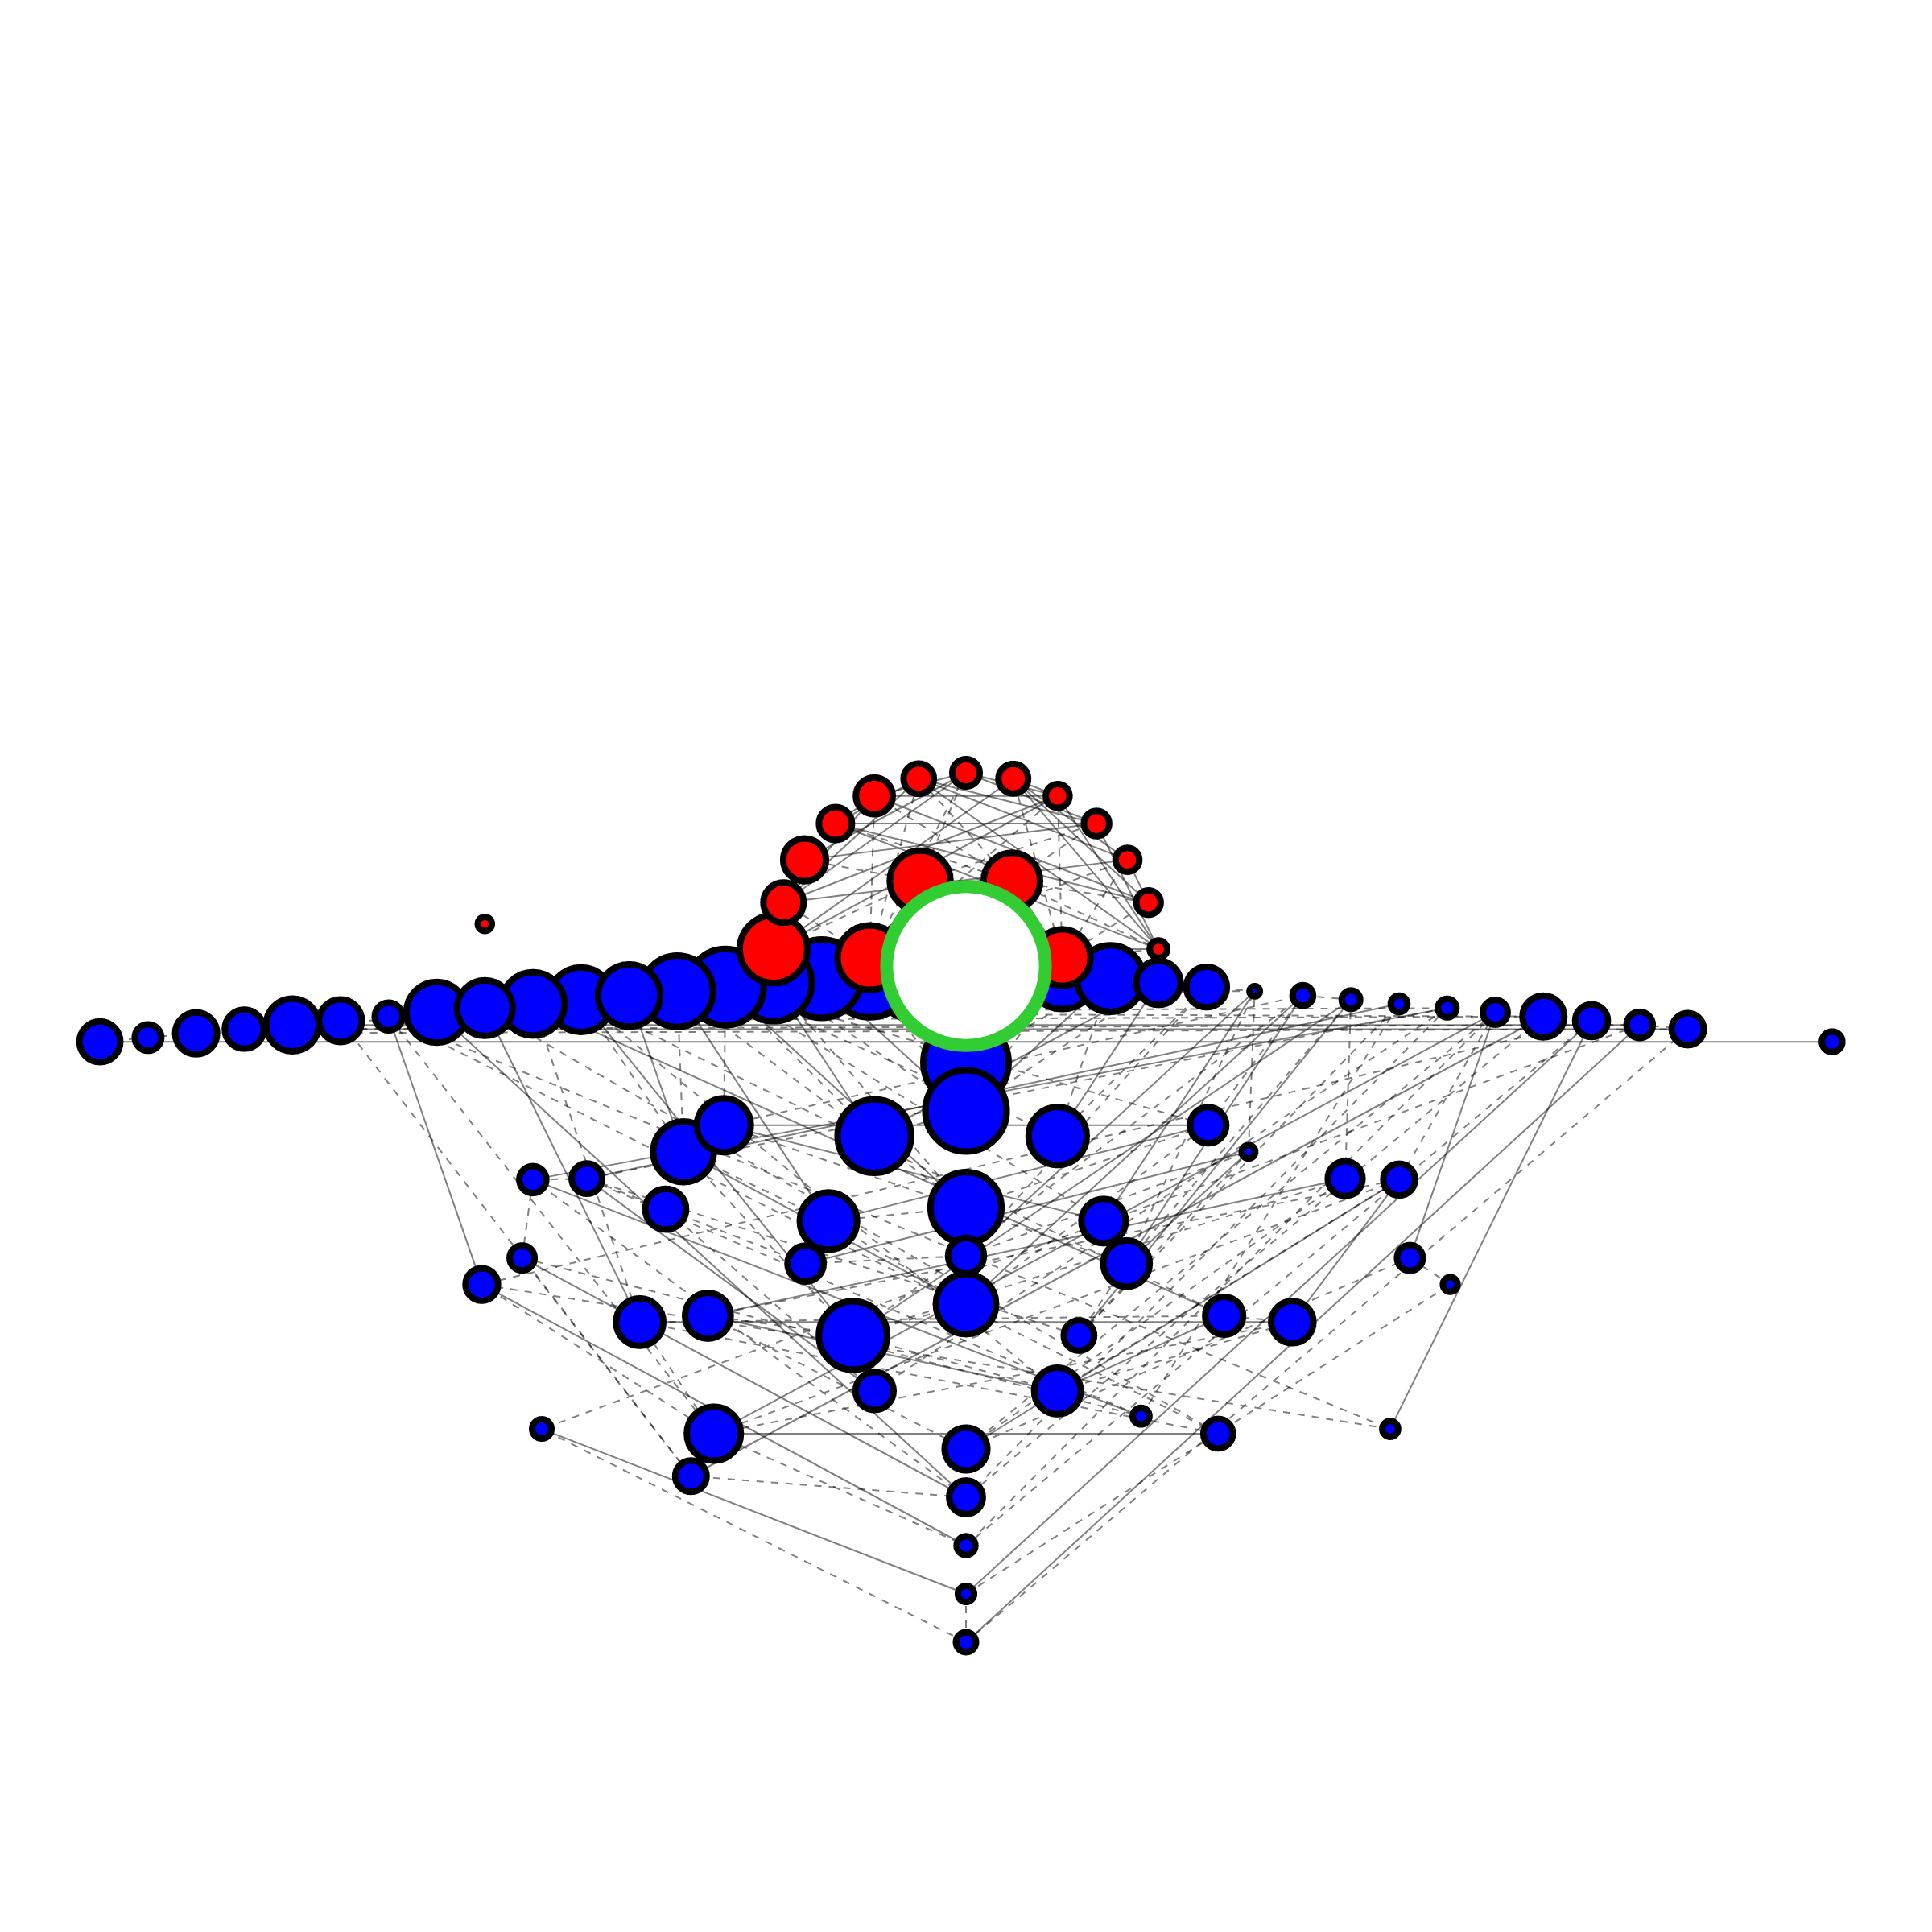
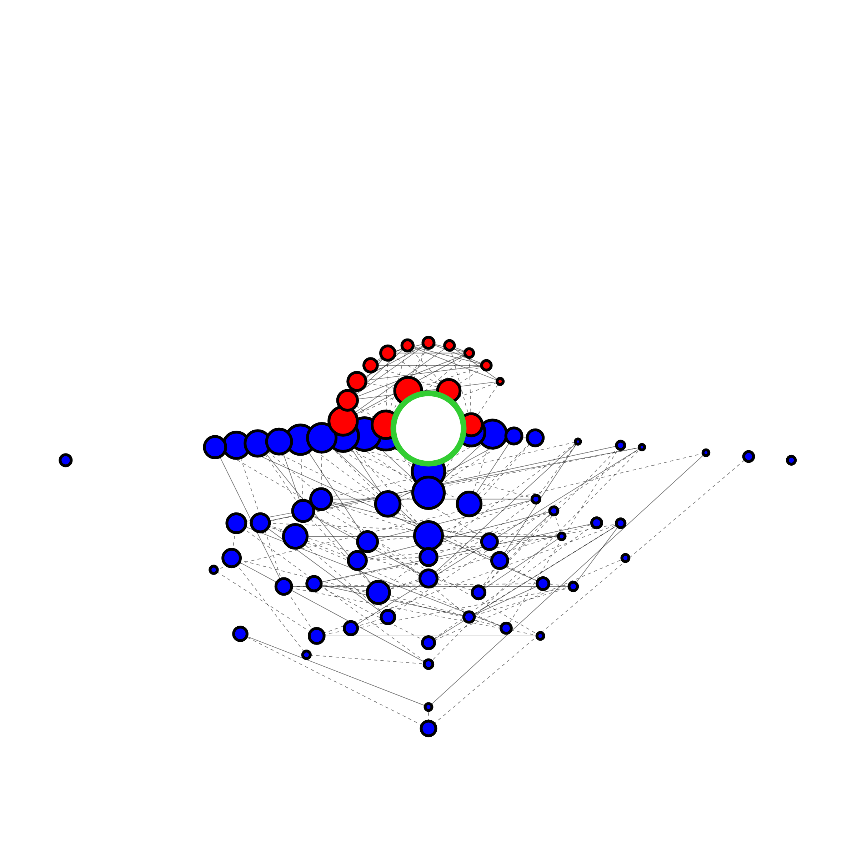
WT_sgAB_R1_sense
WT_sgAB_R1_branch
WT_sgAB_R1_cmv
Frequency Size Scale
Frequency Size Scale
≥1
≥1
10⁻¹
10⁻²
10⁻³
10⁻⁴
10⁻¹
≤10⁻⁵
10⁻²
10⁻³
10⁻⁴
≤10⁻⁵
Ratio [Sense / Branch∆]
Ratio [Sense / Branch∆]
3/2
5/4
1
4/5
3/2
2/3
5/4
WT_sgAB_R2_sense
WT_sgAB_R2_branch
WT_sgAB_R2_cmv
1
4/5
2/3
Variation Types
Variation Types
Insertion
Deletion
Insertion
Deletion
None
None
Vertex Outline
Vertex Outline
Reference
Reference
Non-reference
Non-reference
Edge Types
Edge Types
WT_sgA_R1_sense
WT_sgA_R1_branch
WT_sgA_R1_cmv
Substitution
In/del
Substitution
In/del
WT_sgB_R2_sense
WT_sgB_R2_branch
WT_sgB_R2_cmv

